Slide 1
Week 1

Slide 2
Math Corner
There are nine puppies in the yard.
Six more come to join them.
How many puppies are there altogether?

Slide 3
Math Corner
What number is ten less than 75? How do you know? Draw a model.

Slide 4
Math Corner
Brett got some books from the library. The dot on the number line shows how many books Brett has that belong to him. Each hop shows a book Brett got at the library.
Part A
How many books did Brett start with? Explain your answer.
Part B
How many books did Brett get from the library? Explain your answer.
Part C
Write the addition problem that shows how many books Brett has after he goes to the library.
Part D
Write a subtraction problem to show how many books Brett will have after he gives the books back to the library.

Slide 5
Math Corner
Katie has 17 ice cream bars. She gave 3 ice cream bars to her friends. How many ice cream bars does she have now? Draw a model.

Slide 6
Math Corner
Draw a clock that shows 8:00. Tell what you are usually doing at that time.

Slide 7
Math Corner
1. How many fingers are there on three hands? Write a number sentence to show your thinking.
2. How many more fingers would we need to make 20? Use a number line to show your thinking.

Slide 8
Week 2

Slide 9
Math Corner
1. Draw one way you can show 77. How can you represent this number using base ten blocks?
2. Draw a number that is 10 less than 77 using base ten blocks.
3.Write a number sentence using the greater than or less than symbol.

Slide 10
Math Corner
1. Draw base ten blocks to represent the following numbers:
25, 44, 68, 33
Put the numbers in groups of two.
Write a number sentence to compare the numbers.

Slide 11
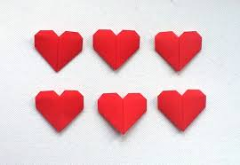
Open Response
Addison has the number of hearts shown.
Part A
How many hearts does Addison have?
Part B
Addison is given 4 more hearts. She counts to add the 4 hearts to Part A. What are the 4 numbers
Addison counted?
Part C
If Addison gives 5 hearts away to a friend from Part B, how many hearts does she have now? Show your work.

Slide 12
Math Corner
Look at the numbers below and think about place value. Can you tell how many tens and ones are in each number? Use a T-Chart to help you!
21, 49, 13, 27, 72

Slide 13
Math Corner
Consuela has five tens and 3 ones.
How can you write this number?
Represent it using base ten blocks.
3. How many dimes and pennies would that be?

Slide 14
Math Corner
Bryce has 6 dimes and 4 pennies.
How many more pennies are needed to trade the pennies for another dime?
What is the value of seven dimes?
How many pennies do you need to trade for seven dimes?

Slide 15
Week 3

Slide 16
Math Corner
Ms. Cowan wrote this number sentence on the board:
+ 4 + 7 = 20
What strategy can you use to help you find the missing number?

Slide 17
Math Corner
Stacey has 11 ice cream bars. She gets 9 more ice cream bars from the store.
How many ice cream bars does she have now? Draw a model.
How would your model look using base ten blocks?

Slide 18
Open Response
Jada shops for a new clock. The picture shows what time one of the clocks shows while Jada shops.
Part A
What hour does the clock show? Explain your answer.
Part B
How many minutes past the hour does the clock show? Explain your answer.
Part C
What time does the clock show?
Part D
Another clock in the store shows the time 3:00. Draw a picture of an analog clock showing 3:00.

Slide 19
Math Corner-
Draw two ways to make 10¢.
Draw two ways to make 20¢.
What coins did you use?
Which coin is the best one to use? Explain your thinking

Slide 20
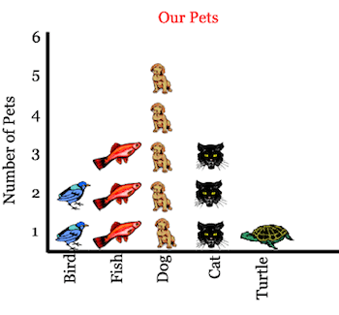
Math Corner-
1.What information can you learn from the graph below?
2.How many pets are there in all? What do you have to do to find this information?
3. Compare the number of birds and dogs.
Write a number sentence to explain your thinking.

Slide 21
Week 4

Slide 22
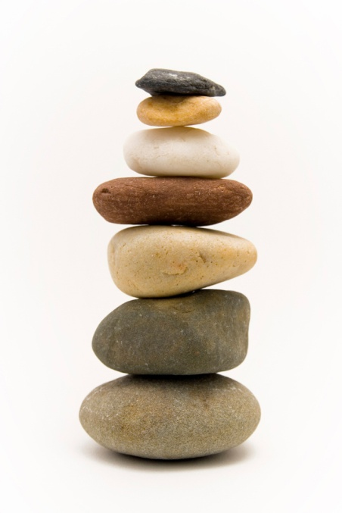
Math Corner
Sally has a rock collection. When her mother asked her how many rocks she had, she said that she had four tens and six ones. How many rocks are in Sally’s collection?
What if Sally had 10 more rocks. How many would that be?

Slide 23
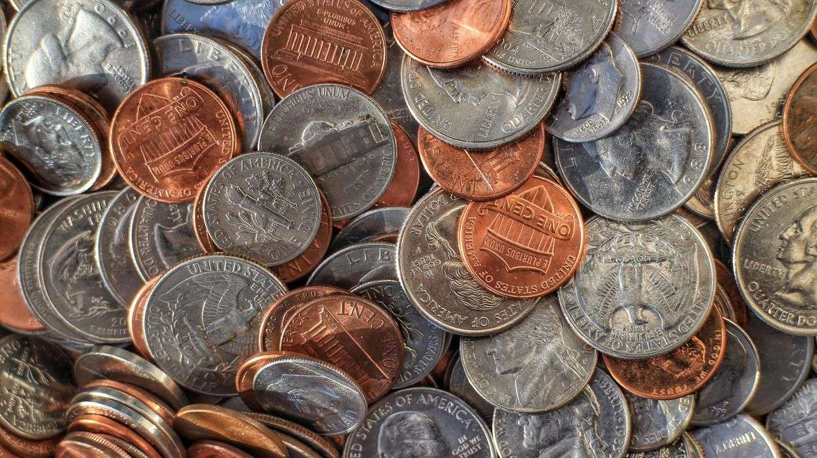
Math Corner
Cathy has sixty-seven coins in her coin collection book. 5 coins fell out of her book. How many coins does she have now? Show your thinking.

Slide 24
Open Response
Ray looks at the weather each day at noon. The table shows the kind of weather Ray saw each
day.
Part A
How many snowy days did Ray see?
Part B
How many sunny days did Ray see?
Part C
How many more snowy days did Ray see than sunny days? Show your work.
Part D
Ray records 6 more rainy days. Explain how the table changes.

Slide 25
Math Corner
The number is 88. Can you tell:
10 more?
10 less?
Five more?
Five less?
Write number sentences to compare your numbers using the greater than and less than symbol.

Slide 26
Math Corner
Mrs. Smith has 18 students. 10 of them are girls. How many are boys? Solve with pictures, numbers, and words.

Slide 27
Math Corner
Using today’s lunch choices,
Create a tally table.
Create a bar graph.
Write 3 questions that can be answered from this data.

Slide 28
Review

Slide 29
Math Corner-Monday
Today’s number is :10
How many ways can you think of to ADD to reach this SUM?
How many ways can you think of to subtract to reach this DIFFERENCE?
**Bonus: Create a fact family using the numbers 4, 3, and 7

Slide 30
Math Corner-Tuesday
Your numbers are :
2, 6, and 8
Use these numbers to make an addition sentence.
Use these numbers to make a subtraction sentence.
Can you create the ENTIRE fact family?

Slide 31

Open Response
Yesterday morning there were puppies at the Pet Store.
Part A
How many puppies needed a new home?
Part B
Today there are 6 more puppies for sale. How many puppies are there now? Use pictures, numbers, or words, to show your work.
Part C
Ten people come and buy puppies. How many puppies still need a new home? How can you prove your thinking?

Slide 32
Math Corner-Wednesday
Look at the numbers below and think about place value. Can you tell how many tens and ones are in each number? Use a T-Chart to help you!
17, 38, 46, 55, 98

Slide 33
Math Corner-Thursday
Kevin has some ice cream bars. He gave 7 ice cream bars to his friends. Now he has 2 bars left. How many ice cream bars did he start with? Draw a model.

Slide 34

Math Corner-Friday
Cathy has 37 coins in her coin collection book. 10 coins fell out of her book. How many coins does she have now?

